Slide 1
SPECIAL USE PERMIT CASE NUMBER WSUP20-0002
Boneyard Flat Grading Phase 2
Washoe County Board of Adjustment
April 16, 2020

Slide 2
Request
Excavation of approximately 1,000,000 (additional) cubic yards of earthen material from the Boneyard Flat area to be used as fill material throughout the Eagle Canyon residential area and the Spanish Springs Business Park industrial area.
The project is also intended to increase the holding capacity of the Boneyard Flat flood pool.

Slide 3
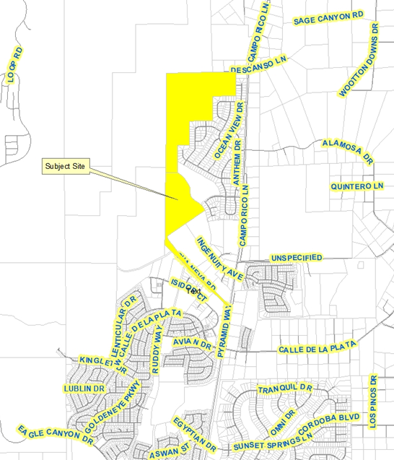
Vicinity Map

Slide 4
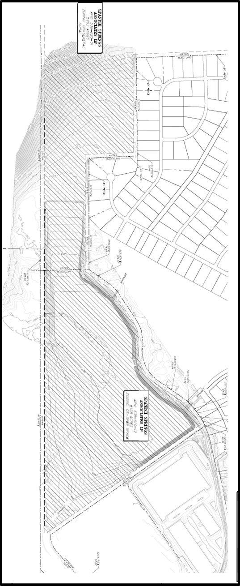
Grading
Plan

Slide 5
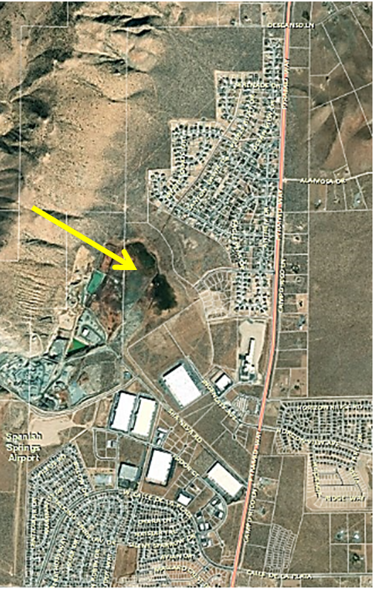
Over Head Photo

Slide 6
Overview
This is phase 2 of the request
Continue:
  50 – foot buffer adjacent to property lines
  4:1 slopes
  Final grading will mimic natural contour
  Compliance with generally applicable codes
Increase stormwater capacity

Slide 7
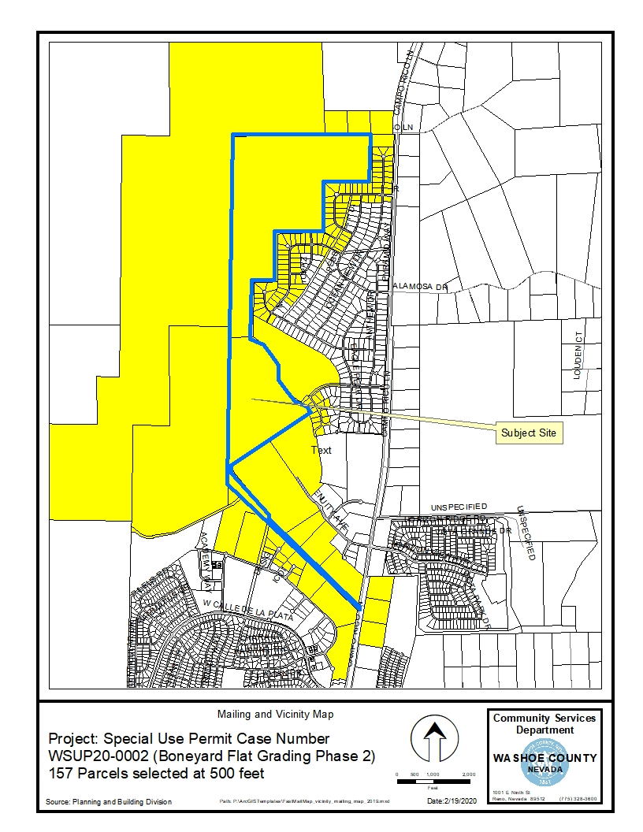
Public Notice & CAB
Notice sent to 157 affected property owners
Spanish Springs CAB reviewed the application on March 4, 2020:
Recommended approval:
  Flood mitigation is a benefit

Slide 8
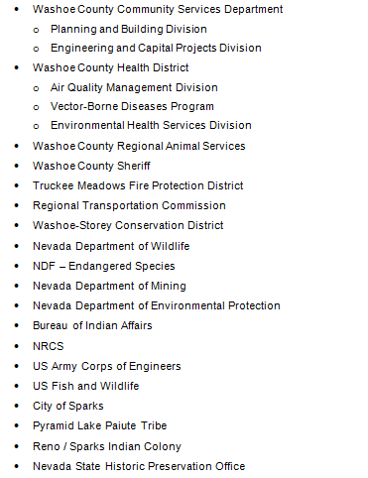
Reviewing Agencies
No recommendations for denial were received.

Slide 9
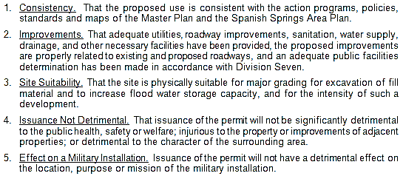
Special Use Permit Findings
Staff comments on findings are on page 8 of the staff report.

Slide 10
Recommendation
After a thorough analysis and review, Special Use Permit Case Number WSUP20-0002 is being recommended for approval with conditions.

Slide 11
Possible Motion
I move that, after giving reasoned consideration to the information contained in the staff report and information received during the public hearing, the Washoe County Board of Adjustment approve with conditions included at Attachment A, Special Use Permit Case Number WSUP20-0002 for Spanish Springs Associates, LP, having made all five findings in accordance with Washoe County Code Section 110.810.30

